Slide 1
Chapter 4: Business Process and Functional Modeling

Slide 2
Objectives
Understand the process used to identify business processes and use cases.
Understand the process used to create use-case diagrams
Understand the process used to model business processes with activity diagrams.
Understand the rules and style guidelines for activity diagrams.
Understand the process used to create use case descriptions.
Understand the rules and style guidelines for use case descriptions.
Be able to create functional models of business processes using use-case diagrams, activity diagrams, and use case descriptions.

Slide 3
Introduction
Now begin the process of turning the requirements into functional models
Models are logical; i.e., independent of how they are implemented (manual or computerized)
Develop use-cases from the requirements
Use-case: how a business system interacts with its environment
Includes a diagram and a description to depict the discrete activities that the users perform
Develop activity diagrams from the use-cases
These model the business processes or how a business operates
Used to illustrate the movement of objects (data) between activities

Slide 4




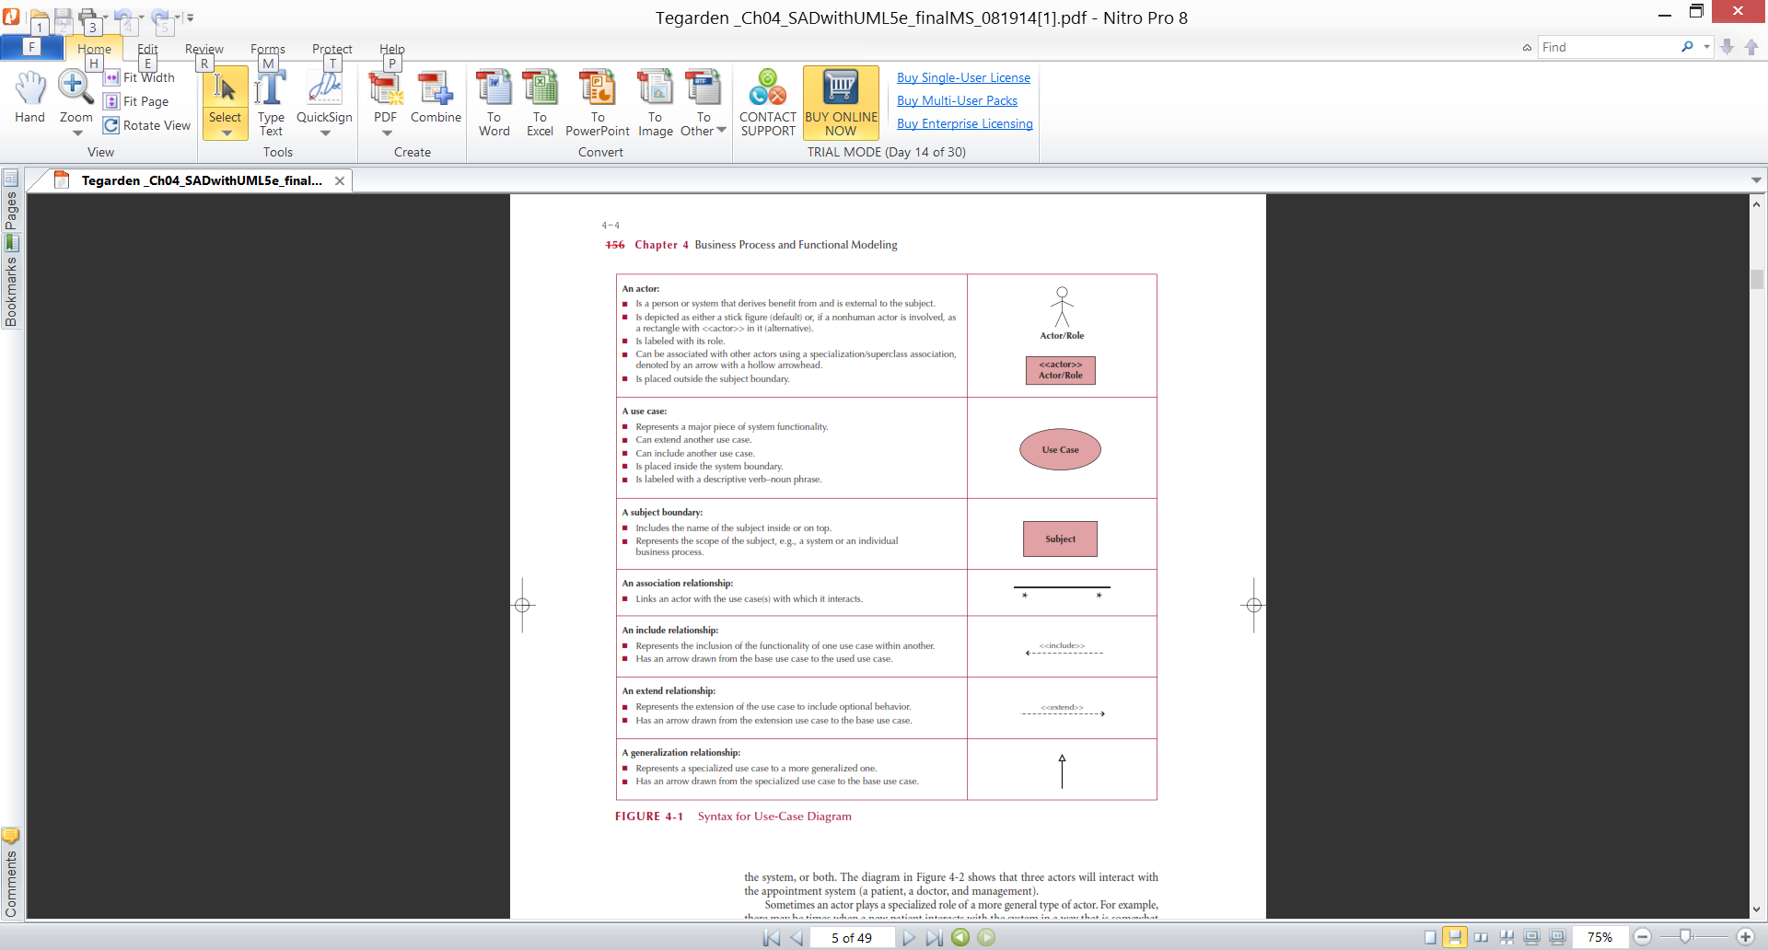
Business Process Identification With Use-Cases
Elements of Use-Case Diagrams
Actors: users or other interacting systems
Associations: lines to connect actors and use-cases
Interactions, inclusions, extensions or generalizations
Use-case: a major process in the system that gives a benefit to the users
Subject boundary: a named box that depicts the scope of the system
An association relationship: links an actor with the use case(s) with which it interacts

Slide 5
Business Process Identification With Use-Cases(Cont.)
Elements of Use-Case Diagrams
An include relationship: Represents the inclusion of the functionality of one use case within another
An extend relationship: Represents the extension of the use case to include optional behavior.
A generalization relationship: Represents a specialized use case to a more generalized one.

Slide 6
Identifying Major Use-Cases
Review the requirements definition
Identify the subject’s boundaries
Identify the primary actors and their goals
Identify the business processes and major use-cases
Carefully review the current set of use-cases
Split or combine some to create the right size
Identify additional use-cases

Slide 7
Create a Use-Case Diagram
Draw the subject boundary
Place & draw the actors
Place & draw the use-cases
Add the associations

Slide 8
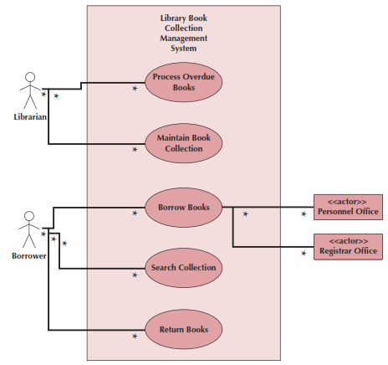
Example Use-Case
Library Book Collection
Management System
Use Case Diagram

Slide 9
BPM With Activity Diagrams
Business processes consist of a number of activities
Activity diagrams depict the sequence of these activities
Diagrams are abstract and describe processes in general
They model behavior independent of objects
Can be used for any type of process

Slide 10
Activity Diagram Syntax
Action or Activity
Represents action or set of actions
Control Flow
Shows sequence of execution
Initial Node
The beginning of a set of actions
Final Node
Stops all flows in an activity
Decision Node
Represents a test condition

Slide 11
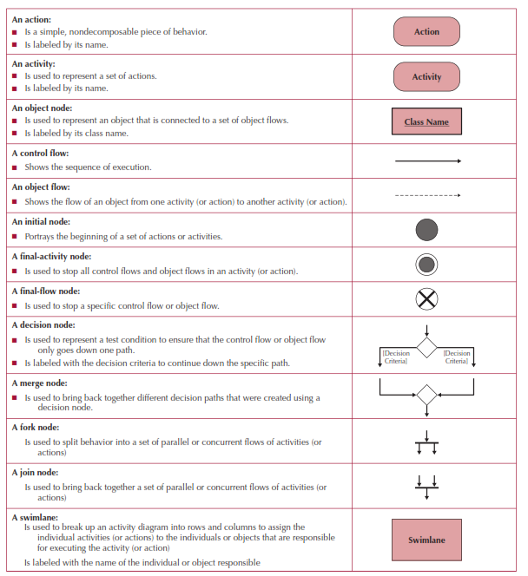
Activity Diagram Symbols

Slide 12
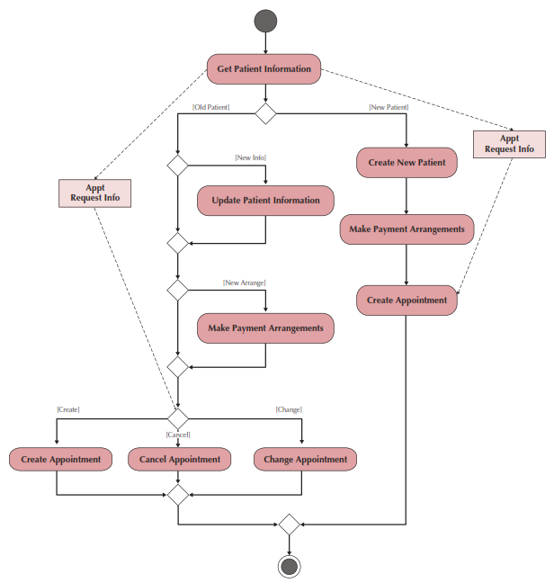
Sample Activity Diagram

Slide 13
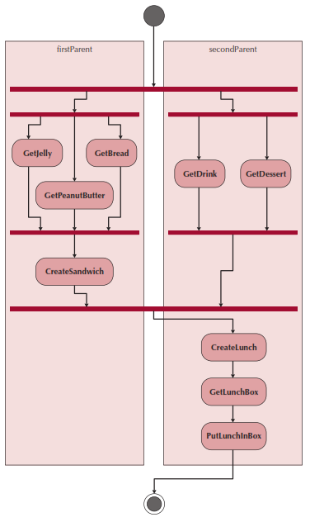
Swim lanes
Used to assign responsibility to objects or individuals who actually perform the activity
Represents a separation of roles among objects
Can be drawn horizontally or vertically

Slide 14
Elements of a Use Case Description
Overview:
Name, ID Number, Type, Primary Actor, Brief Description, Importance Level, Stakeholder(s), Trigger(s)
Relationships:
Association: Communication between the use case and the actors
Extend: Extends the functionality of a use case
Include: Includes another use case
Generalization: Allows use cases to support inheritance
Flow of events
Normal flow: the usual set of activities
Sub-flows: decomposed normal flows to simplify the use-case
Alternate or exceptional flows: those not considered the norm
Optional characteristics (complexity, time, etc.)

Slide 15
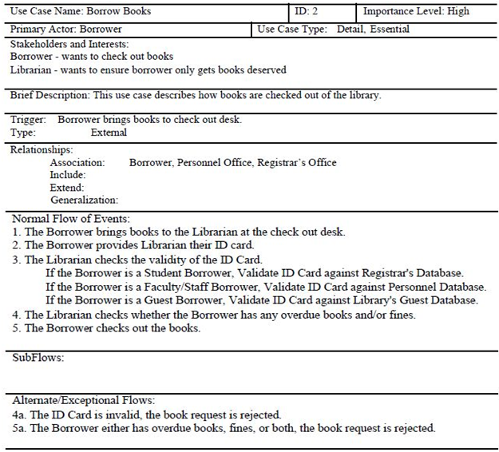
Example Use-Case Description

